Slide 1
CSC473 - Dynamic Cloth Simulation: Utilizing Spring-Mass Systems
Churong Yu

Slide 2
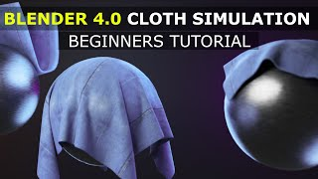
Introduction to Cloth Simulation

Slide 3
Overview

Slide 4
Overview of Blender’s Role in This Project
bpy.context
BMesh Module

Slide 5
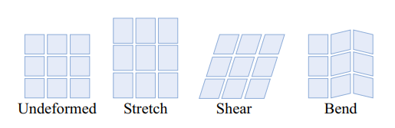
Understanding the Mass-Spring Model

Slide 6
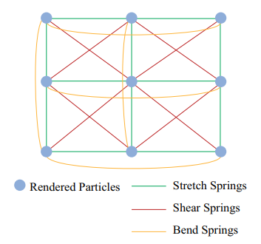
Understanding the Mass-Spring Model

Slide 7
Underlying Math

Slide 8
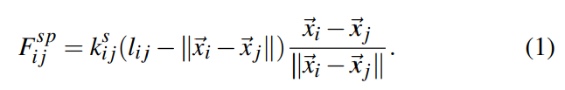
Spring Force

Slide 9

Damping Force

Slide 10


Simulation Step: Symplectic Euler

Slide 11

Put Everything Together

Slide 12
Demo

Slide 13

Demo 1: A Simple Cloth Simulation
M = 0.5
Kst = 500
Ksh = 60
D = 1

Slide 14
Super ELasticity Effect

Slide 15

Demo 2: First solution to Super Elasticity Effect
M = 0.1
Kst = 800
Ksh = 60
d=1

Slide 16
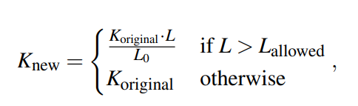
Introduce to K Adjustment Method

Slide 17

Demo 2: K Adjustment Solution of Super Elasticity Effect

Slide 18
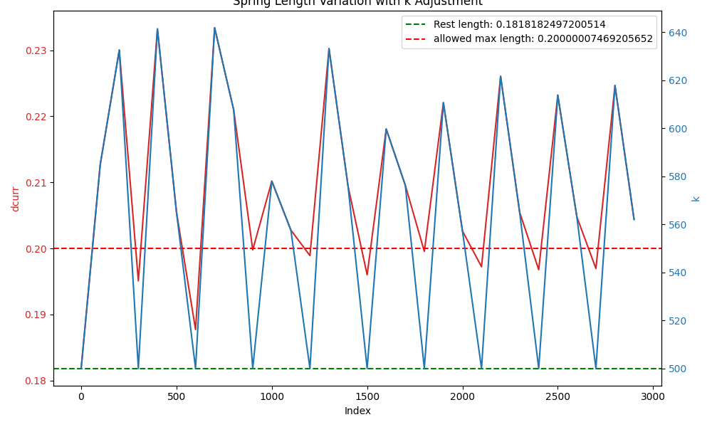
Spring Length Variation With K Adjustment

Slide 19
A Bit More About Stiffness
Stretch stiffness affects how much the fabric resists being stretched when pulled. Higher stretch stiffness means the fabric is harder to stretch, maintaining its original shape better. The higher the stretch stiffness, the less the fabric will elongate.
Shear stiffness affects how much a fabric will deform when subjected to shear forces. Higher shear stiffness makes it more difficult for the fabric to be sheared, thus maintaining its shape stability and structural identity.

Slide 20
Demo 4: Small Stretch Stiffness Vs Large Stretch Stiffness
M = 0.1, Kst=100, Ksh=60, D=1
M = 0.1, Kst=500, Ksh=60, D=1

Slide 21
Demo 5: Small Shear Stiffness Vs Large Shear Stiffness
M = 0.1, Kst=500, Ksh=10, D=1
M = 0.1, Kst=500, Ksh=80, D=1

Slide 22
A Bit More About Euler

Slide 23
Demo 6: Large Time Step
Time Step =
1/80

Slide 24
Summarize

Slide 25
Future Work

Slide 26
Future Works…
User Interface
Bend Spring
More physical simulation: external forces & Collision
Different Method
Non-linear spring

Slide 27
Thank You!

